Slide 1
An introduction to gpu computing and cuda architecture
罗汉杰，机器人组，CVTE中央研究院

Slide 2
motivation

Slide 3





motivation
Image quality computation
Image quality computation
Exposure
prediction
Image quality computation
Exposure
control
Exposure
Image quality computation
Image quality computation
Notes:
预计18个月会将芯片的性能提高一倍。
Power=number of cores; Power = (frequency)3

Slide 4
motivation
Notes:
预计18个月会将芯片的性能提高一倍。
Power=number of cores; Power = (frequency)3

Slide 5
GPU Architecture
CUDA Programming Model
Case Study: Matrix transpose

Slide 6
GPU Architecture

Slide 7
“If you were plowing a field, which would you rather use: Two strong oxen or 1024 chickens?”
Seymour Cray
Notes:
西摩·克雷（Seymour Cray），1958年设计建造了世界上第一台基于晶体管的超级计算机。

Slide 8
Getting PERFORMANCE
Increase processor speed
Moore's law doesn't hold anymore
Power scales as frequency
Parallel executing
Notes:
预计18个月会将芯片的性能提高一倍。
Power=number of cores; Power = (frequency)3

Slide 9
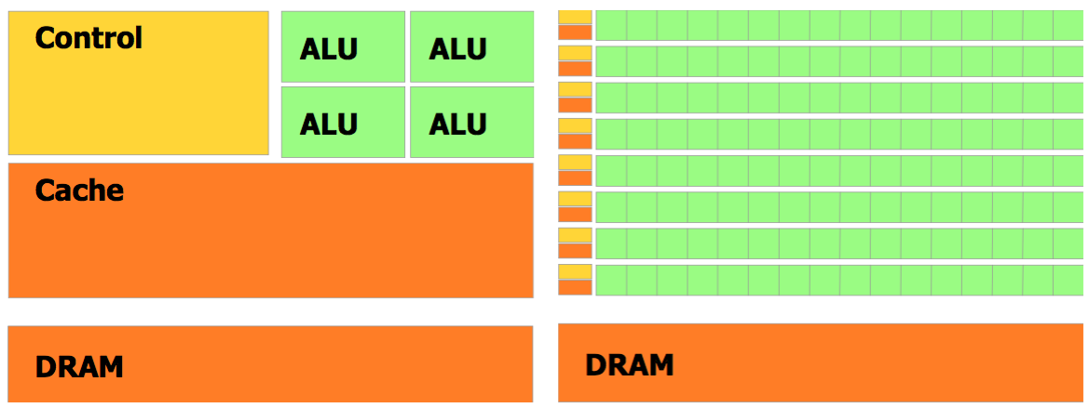
gpu vs cpu
CPU GPU
Notes:
Global memory

Slide 10
gpu vs cpu
CPU
Low compute density
Complex control logic
Large caches
Low latency tolerance
Optimized for serial operations
GPU
High computer density
High data-parallel, throughput(150GB/s VS 25GB/s)
High computations per memory access
High Latency Tolerance
Built for parallel operations
Notes:
强于预测执行，乱序执行
减少每个线程内的延迟（核等待数据的时间）
吞吐量

Slide 11
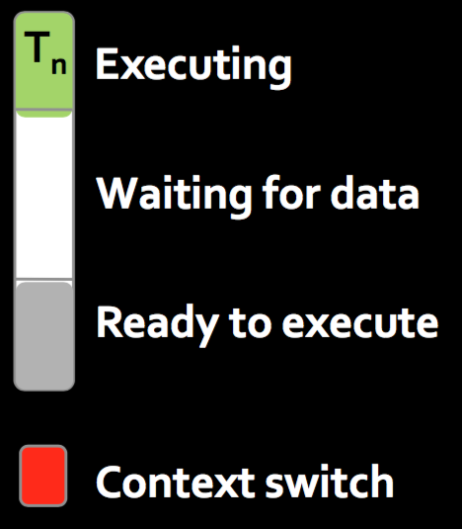

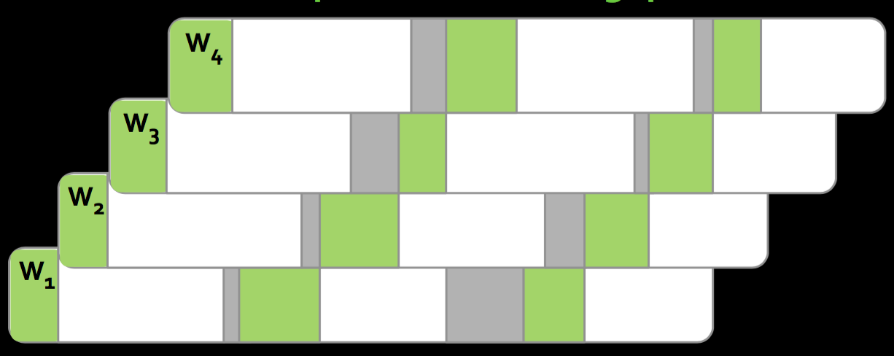
gpu vs cpu
CPU architecture attempts to minimize latency within each thread
GPU architecture hides latency with computation from other thread warps
Notes:
强于预测执行，乱序执行
减少每个线程内的延迟（核等待数据的时间）

Slide 12
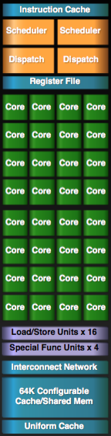
GPU Architecture
Streaming Multiprocessors (SMs)
Perform the actual computations
Each SM has its own: Control units, registers, execution pipelines, caches
Notes:
940mx , 3 sms , 128 cuda cores

Slide 13
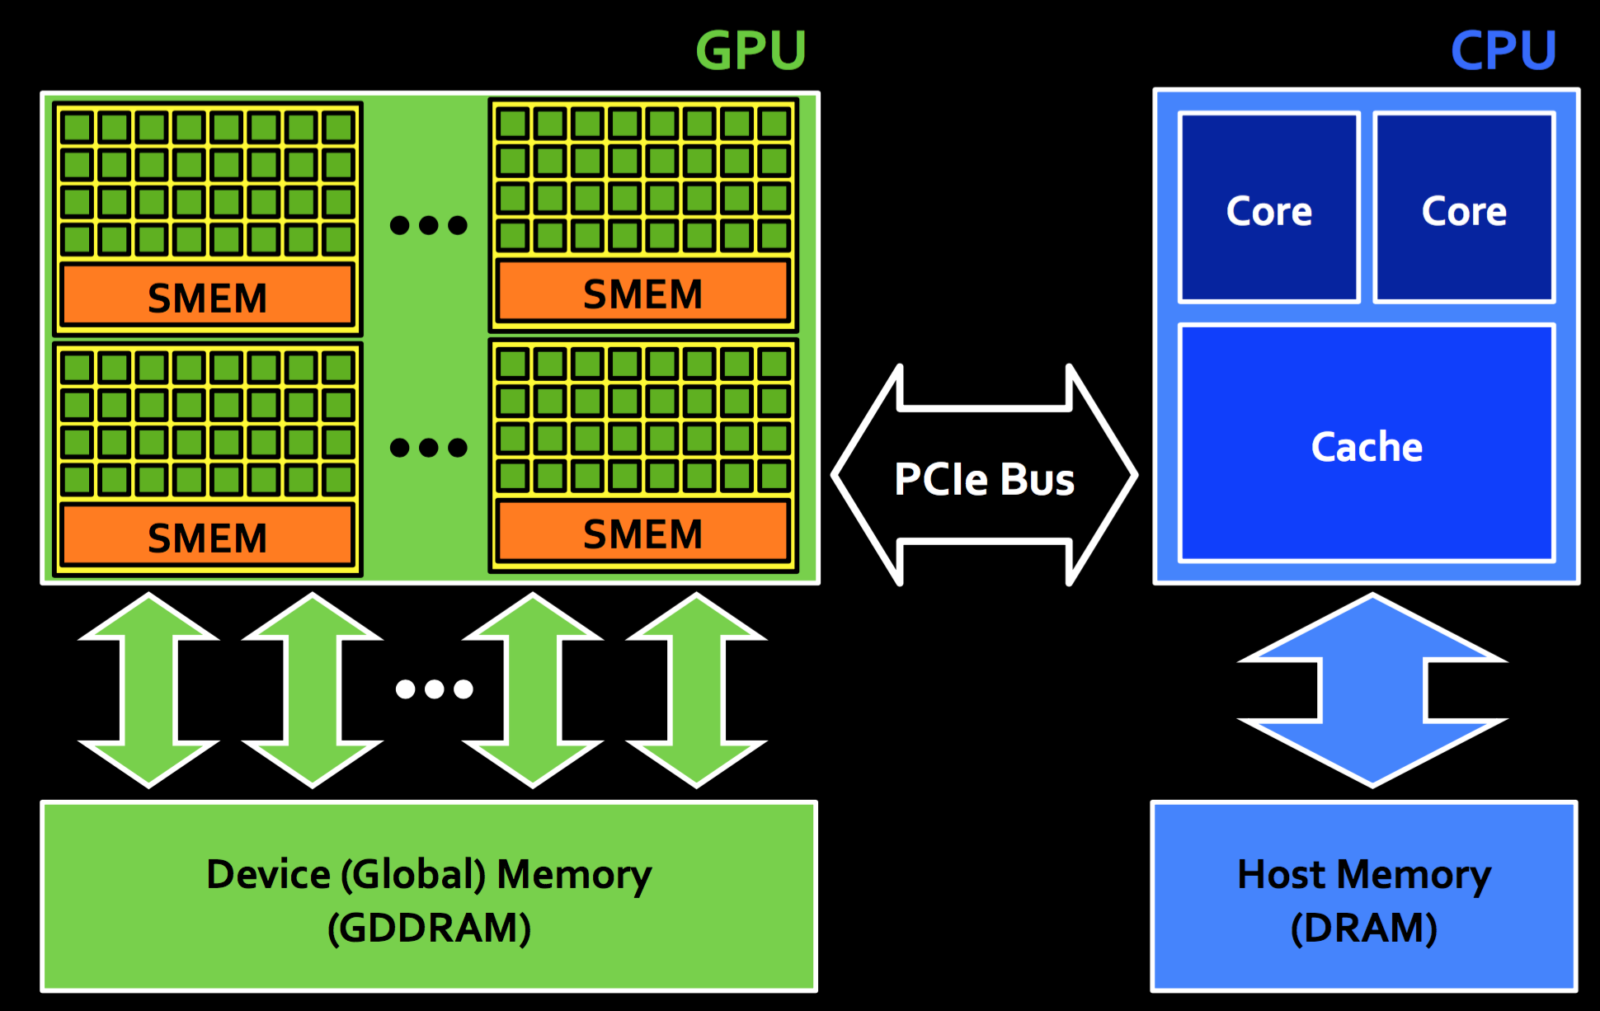
Canonical execution flow
Copy data from CPU memory to GPU memory
Launch kernel on GPU
Execute kernel on GPU
Copy data from GPU memory to CPU memory
Notes:
Global memory

Slide 14
CUDA PROGRAMMING MODEL

Slide 15
Thread hierarchy
Thread: Sequential execution unit
All threads execute same sequential program
Threads Block: a group of threads
Threads execute in parallel
Executes on a single Streaming Multiprocessor (SM)
Threads within a block can cooperate
Light-weight synchronization
Data exchange
Grid: a collection of thread blocks
Thread blocks of a grid execute across multiple SMs
Thread blocks do not synchronize with each other
Communication between blocks is expensive

Slide 16
Thread hierarchy
A thread blocks is run on a single SM
The GPU is responsible for allocating the blocks to the SMs
All the SMs run in parallel and independently
An SM may run more than on block
CUDA make few guarantees about when and where thread blocks will run
Independent execution of blocks provides scalability
Blocks can be distributed across any number of SMs

Slide 17
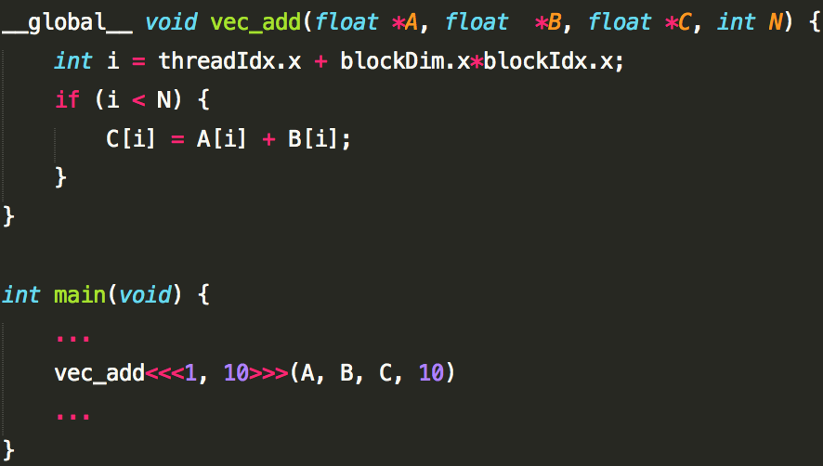
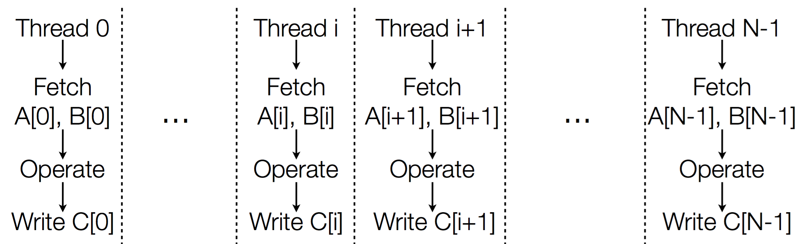
CUDA Kernels
A kernel is executed by many threads
A kernel is a simple C program
Each thread has it own ID
Thousands of threads execute same kernel

Slide 18
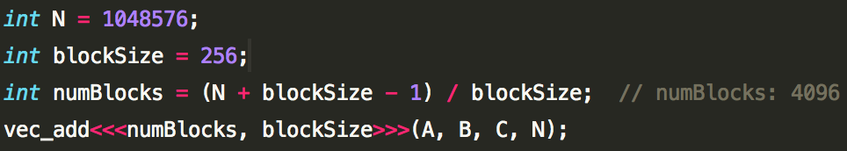
CUDA Kernels

Slide 19
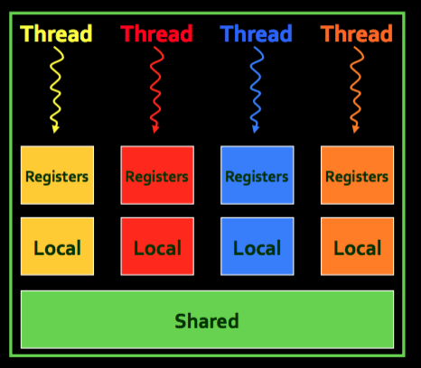
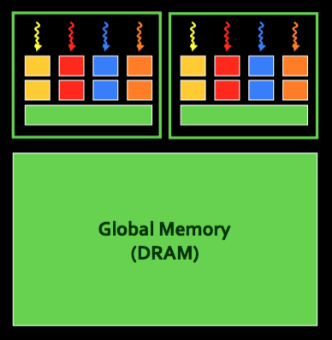
Memory hierarchy
Three types of memory in the graphic card:
Global memory: 4GB
Shared memory: 16 KB
Registers: 16 KB
Latency:
Global memory: 400-600 cycles
Shared memory: a few cycles
Register: Fast
Purpose:
Global memory: IO for grid
Shared memory: thread collaboration
Registers: thread space
Fast
slow

Slide 20
CASE STUDY: matrix transpose

Slide 21
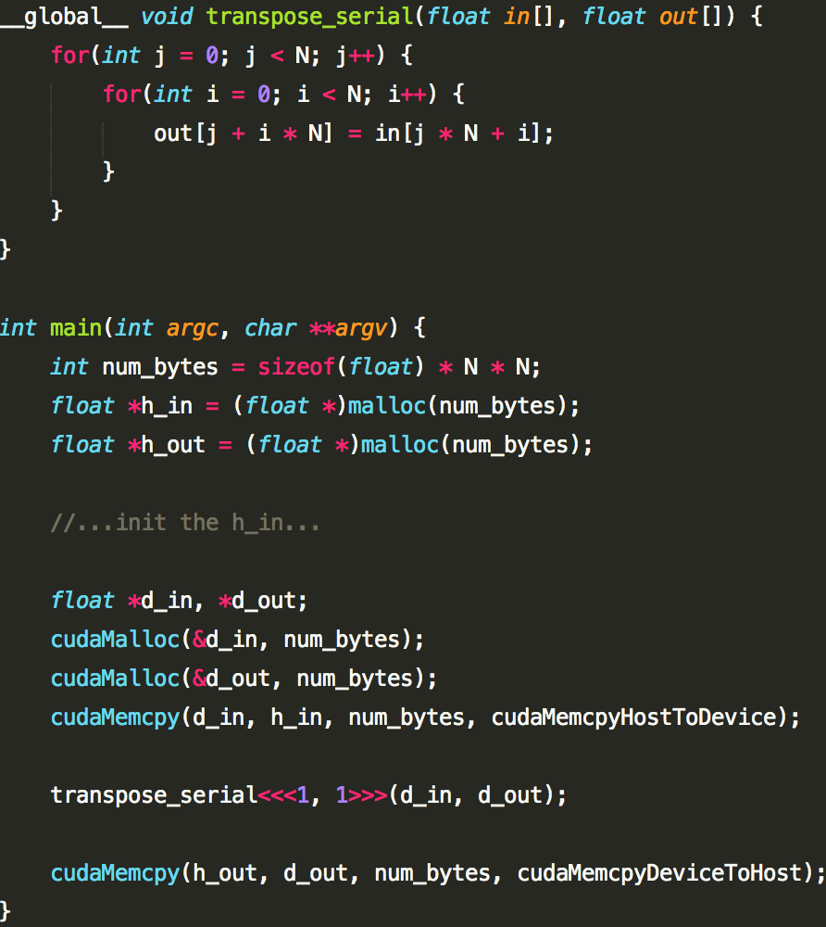
serial
Matrix transpose:
Size: N*N
But wait... GPU computing is about massive parallelism!

Slide 22
Performance
Method | Time | Bandwidth
Serial | 466ms | 0.1%

Slide 23
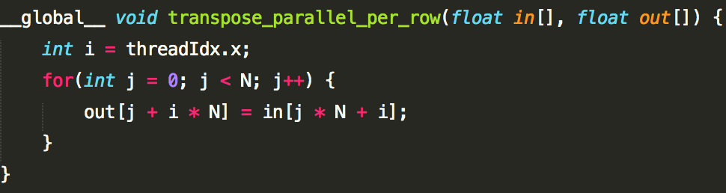
parallel per row
Parallel per row
Instead of executing transpose_serial() once, execute N times in parallel
1 blocks, N thread per block
transpose_serial<<<1, 1>>>
transpose_parallel_per_row<<<1, N >>>

Slide 24
Performance
Method | Time | Bandwidth
Serial | 466ms | 0.1%
Parallel per row | 4.7ms | 4.5%

Slide 25
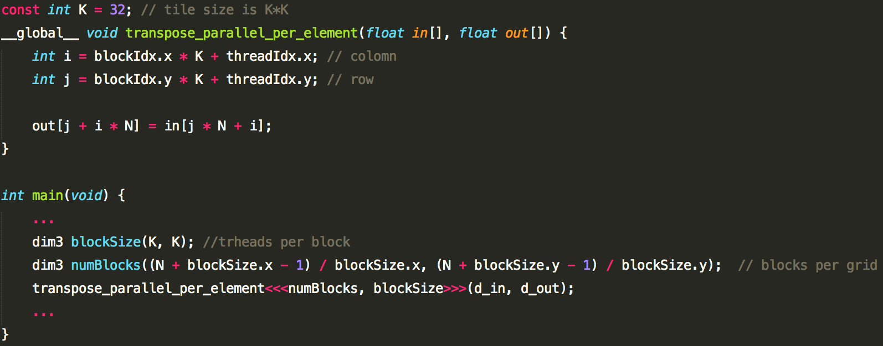
Parallel per element

Slide 26
Performance
Method | Time | Bandwidth
Serial | 466ms | 0.1%
Parallel per row | 4.7ms | 4.5%
Parallel per element | 0.67ms | 17.1%
Most GPU codes are memory limited!
Notes:
内存不能及时将数据传递到SM中，或及时存储运算结果，GPU工作工作效率会大打折扣

Slide 27
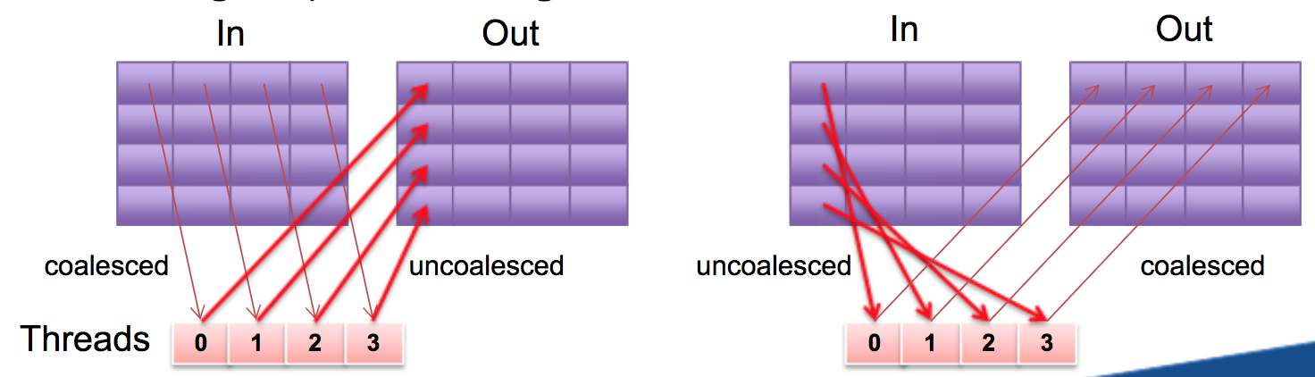
Coalescing
Coalescing: GPU is always accessing global memory/DRAM in petty large chunks, 32 or 128 bytes at a time
Notes:
[,kəʊə'les]

Slide 28
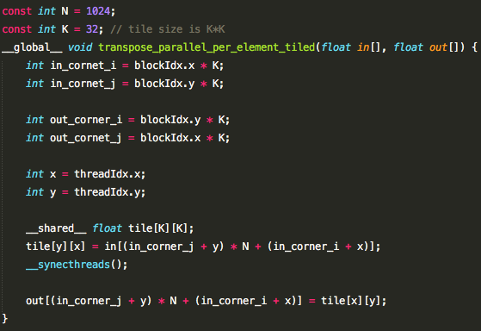
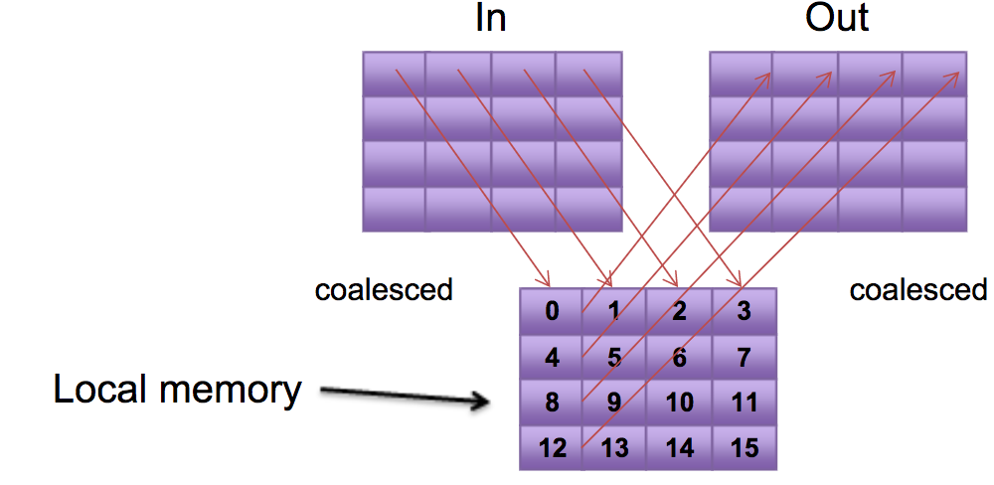
SHARED MEMORY

Slide 29
Performance
Method | Time | Bandwidth
Serial | 466ms | 0.1%
Parallel per row | 4.7ms | 4.5%
Parallel per element | 0.67ms | 31.1%
Shared memory | 0.33ms | 17.1%
Notes:
内存不能及时将数据传递到SM中，或及时存储运算结果，GPU工作工作效率会大打折扣

Slide 30
Reduce average delay
More threads in the block, more time on average they spend waiting.
We have 32*32=1024 threads each block, each threads doing little work, and waiting until all other threads get done!
Reduce the number of threads per block.

Slide 31
Performance
Method | Time | Bandwidth
Serial | 466ms | 0.1%
Parallel per row | 4.7ms | 4.5%
Parallel per element | 0.67ms | 31.1%
Shared memory(K=32) | 0.33ms | 17.1%
Shared memory(k=16) | 0.13ms | 43.5%
Notes:
内存不能及时将数据传递到SM中，或及时存储运算结果，GPU工作工作效率会大打折扣

Slide 32
Optimization
Maximum CUDA Occupancy
Occupancy = Max threads running / Max threads possible
Increasing the effective bandwidth
Useful bytes delivered = average latency * bandwidth
Coalescing global memory
Use shared memory
Minimum time waiting at barriers
Notes:
内存不能及时将数据传递到SM中，或及时存储运算结果，GPU工作工作效率会大打折扣

Slide 33
ACTIVE EXPOSURE CONTROL WITH CUDA
Notes:
预计18个月会将芯片的性能提高一倍。
Power=number of cores; Power = (frequency)3

Slide 34


Question?

